Slide 1
CHAPTER 2
LIMITS AND CONTINUITY

Slide 2
CONTENTS
2.1. The Tangent & Velocity Problems
2.2. The Limit of a Function
2.3. Calculating Limits using the Limit Law
2.4. Continuity
2.5. Limits involving Infinity

Slide 3
2.3. THE LIMIT OF A FUNCTION
2.2.1. Definition of Limits
2.2.2. One-sided Limits

Slide 4
2.2.1 Definition of Limits
By constructing the table of values of the function f(x) = x² – x + 2 for values of x near 2,
we see that the values of f(x) can be made as close to 4 as we like
by taking x sufficiently close to 2.
This fact can also be verified by drawing the graph of f(x).
We say that the limit of f(x) is 4 as x approaches 2.

Slide 5
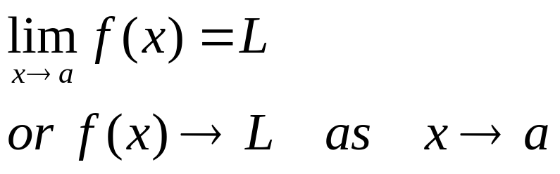
In general we have
Definition. We say that the limit of a function f(x) equals to L as x approaches a if
we can make the values of f(x) arbitrarily close to L (as close to L as we like)
by taking x to be sufficiently close to a but not equal to a
We also write
Note that f(x) needs not be defined for x = a

Slide 6
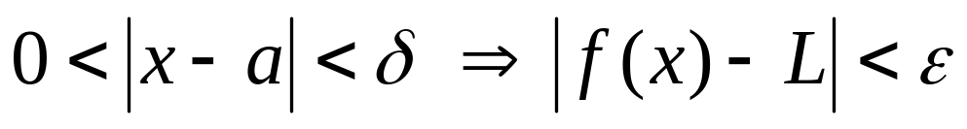
We also have the following formal definition of the limit of a function
Definition. We say that the limit of f(x) equals to L as x approaches a if
given any number ε > 0
we can find a number δ > 0 such that
ε
f
L
δ
a
f(x)
x

Slide 7
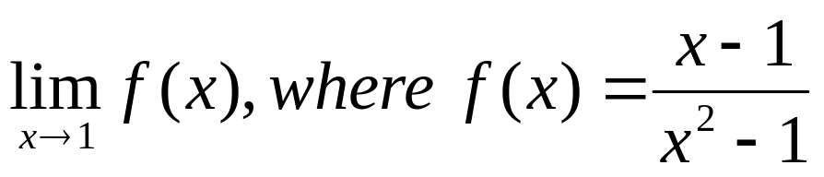
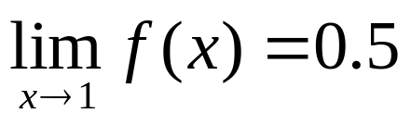
Example. Guess the value of
Solution. Note that f(x) is not defined when x = 1.
From the following tables, we can guess
x<1 | f(x)
0.5 | 0.666667
0.9 | 0.526316
0.99 | 0.502513
0.999 | 0.500250
0.9999 | 0.500025
x>1 | f(x)
1.5 | 0.400000
1.1 | 0.476190
1.01 | 0.497512
1.001 | 0.499750
1.0001 | 0.499975

Slide 8
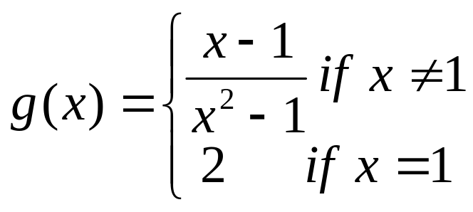
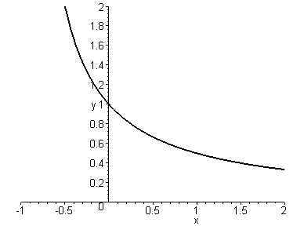
Note that function g defined below have the same limit as x approaches 1
y=f(x)
y=g(x)

Slide 9
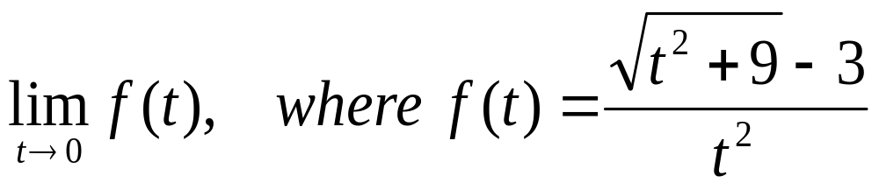
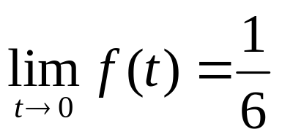
Example. Find
Solution. First we compute the values f(t) for t near 0.
From this table, we can guess
t | f(t)
±1.0 | 0.16228
± 0.5 | 0.16553
± 0.1 | 0.16662
± 0.05 | 0.16666
± 0.01 | 0.16667

Slide 10
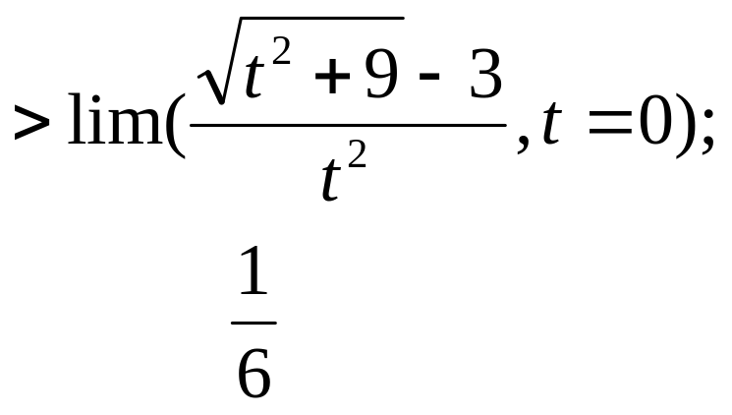
Remark. If we try to compute the values f(t) for smaller values of t by a calculator or by using the command subs of MAPLE we will get strange results:
We can ask MAPLE to compute with up to 10 ⁵²⁴²⁷⁹ decimal digits to improve the result.
t | f(t)
± 0.0005 | 0.16800
± 0.0001 | 0.20000
± 0.00005 | 0.00000
± 0.00001 | 0.00000
However the simple MAPLE command limit would give the correct result

Slide 11
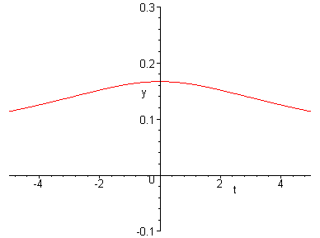
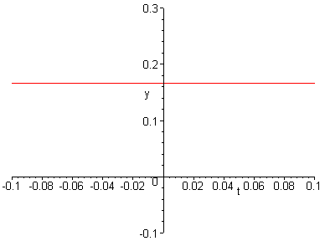
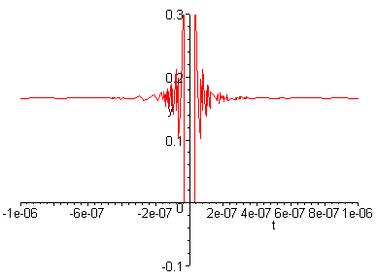
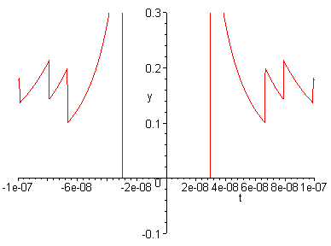
If we graph the function f(t), the same strange phenomenon also occurs

Slide 12
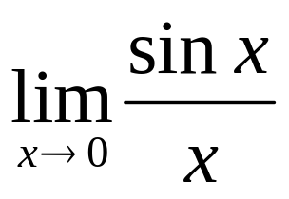
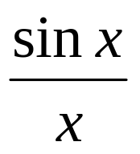
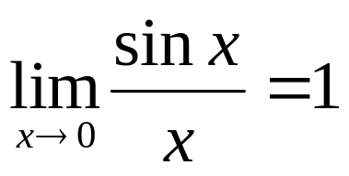
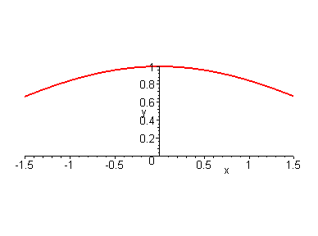
Example. Find
Solution. If we compute the values of
for x near 0 but ≠ 0 we can guess

Slide 13
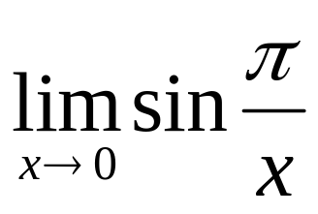
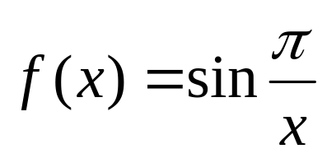
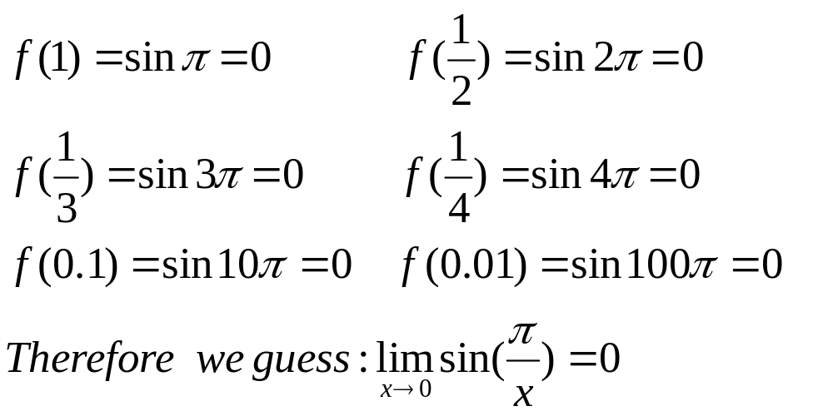
Example. Find
Solution. Evaluating the function
for some small values of x we get

Slide 14
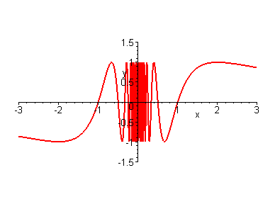
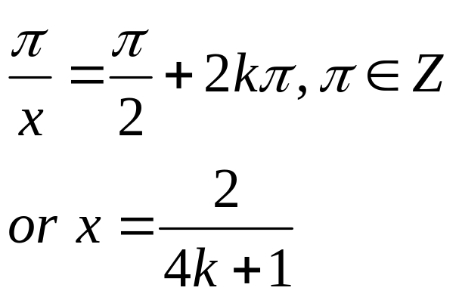
However the guess is wrong since f(x) = 1 for infinitely many values of x namely:
Therefore lim f(x) as x approaches 0 does not exist

Slide 15
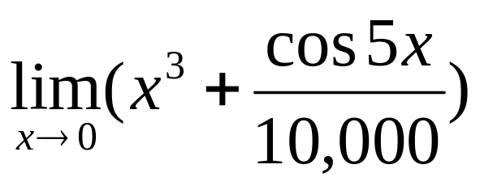
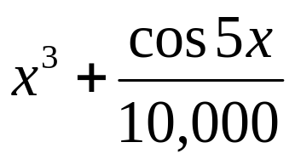
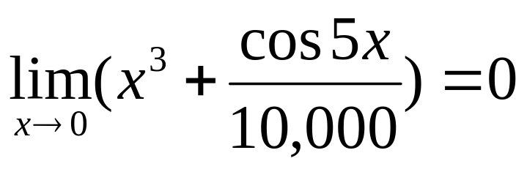
Example. Find
Solution. Evaluating the function for small x we get:
x
1 | 1.000028
0.5 | 0.124920
0.1 | 0.001088
0.05 | 0.000222
0.01 | 0.000101
Hence it appears that

Slide 16
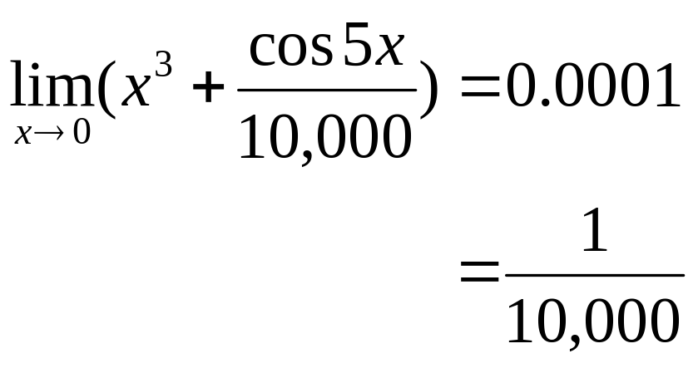
However with smaller values of x we get
This suggests that
x
0.005 | 0.00010009
0.001 | 0.00010000
This fact will be proved later. We can also use the command limit of MAPLE to verify it

Slide 17
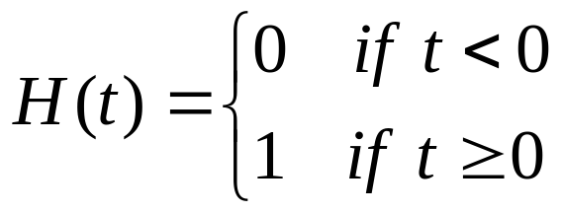
2.2.2 One-sided Limits
The Heaviside function is defined by
y
1
0
t
As t approaches 0 from the left, H(t) approaches 0. As t approaches 0 from the right, H(t) approaches 1. So the limit of H(t) as t approaches 0 does not exit but we have

Slide 18
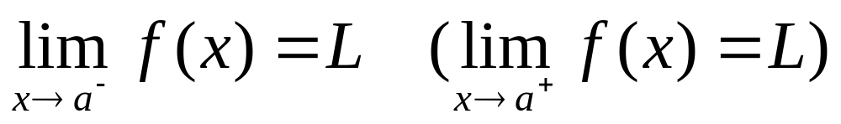
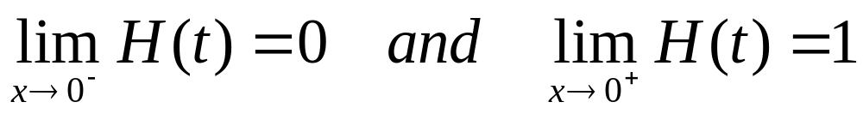
Definition. We say that the left-hand side (right-hand side) limit of f(x) equals L as x approaches a, and write
if we can make the values of f(x) arbitrarily close to L by taking
x sufficiently close to a and less than a (larger than a).
Example. For the Heaviside function we have

Slide 19
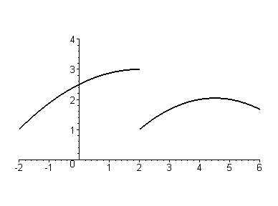
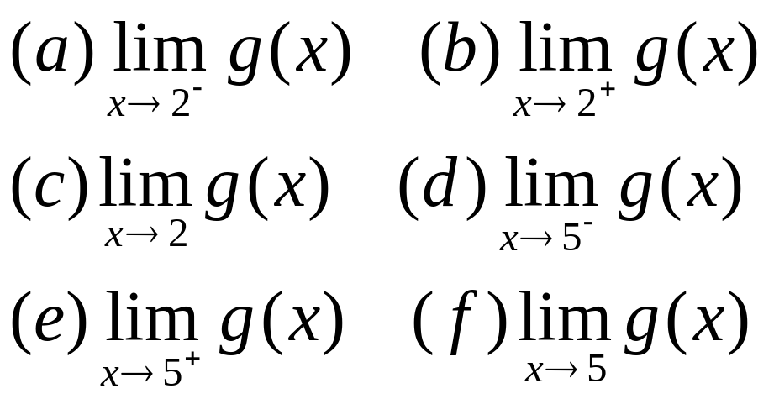
Theorem.
Example. The graph of a function g is given below.
Use it to guess the values of:

Slide 20
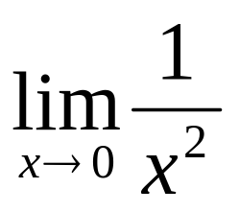
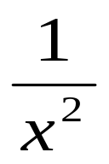
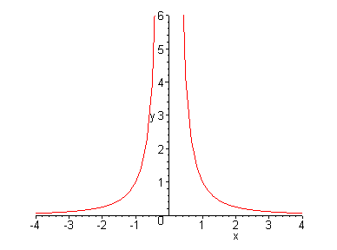
Example. Find if it exists
Solution. As x approaches 0, becomes very large. Thus its
values do not approach any
number, i.e. does not exist
x
±1.0 | 1
± 0.5 | 4
± 0.2 | 25
± 0.1 | 100
± 0.05 | 400
± 0.01 | 10,000
± 0.001 | 1,000,000

Slide 21
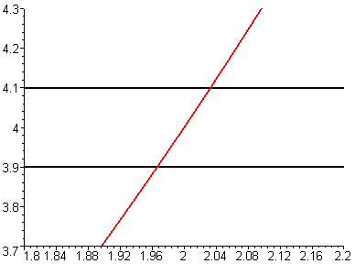
Example. How close to 2 does x have to be to ensure that f(x) = x² – x + 2 is within the distance 0.1 from the number 4?
Solution. The requirement of the outcome is that:
|f(x) – 4| < 0.1
i.e. 4 – 0.1 < f(x) < 4 + 0.1
or 3.9 < f(x) < 4.1
Thus the graph of f must lie between the two lines
y=3.9 and y=4.1

Slide 22
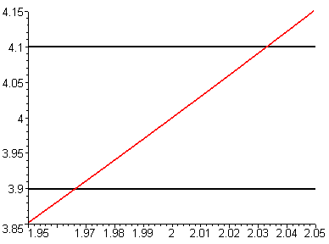
Thus the graph of f must lie between the two lines y=3.9 and y=4.1
Solution. We use MAPLE to plot the graph of f and two lines y=3.9 and y=4.1
From the graphs we can take 1.97< x <2.03, ie⎪x –2⎪<0.03.
This means that for ε = 0.1, we can choose δ = 0.03 in the Formal Definition of limit

